Slide 1
Nebraska DD Rates
January 24, 2022

Slide 2
DD providers in Nebraska need a 30% increase in rates to maintain adequate service levels.
DD Providers are suffering from unprecedented losses and a lack of state support.
5 of Nebraska’s largest providers combined financial data for Q3 2021 compared to Q3 2019 and showed a net margin loss of 12%.
These 5 providers made a combined profit margin of 2.6% in Q3 2019. Q3 2021 showed a net loss among these providers of 10.6%.
BSDC compensation rates increased 20% for technicians in 2020. The 30% increase would allow DD providers to increase their direct support payment rates alongside BSDC and make up for the net margin loss.

Slide 3
DD Support During COVID-19
March 2020-September 2020
The Division for Developmental Disabilities (DDD) increased provider rates by 15% through CMS’s Appendix K.
October 2020-June 2021
DDD announces the end of enhanced rates through a stair-step approach beginning in October 2020 through December 2020. After provider input, DDD retroactively increases rates from January-June 2021 (paid in August 2021).
July 2021-December 2021
No additional state support has been passed to providers. Providers no longer have the flexibility for service provision afforded under Appendix K.
January 2022-June 2022
Governor Ricketts announced 15% increase for DD providers for the last half of SFY 2021-22.

Slide 4
Provider Financial Data
Revenues
HHS Revenue (1915c DD Waivers):
Other Service Revenue:
Total Revenue:
Expenses
Salaries and Wages
Employee Benefits and Taxes
Travel/Transportation
Supplies
Occupancy
Equipment
Contracted Services (non-SLP)
Contracted Services (SLP)
Other Operating Expenses:
Total Expenses:
Profit/(Loss)
Margin:
Jul – Sep 2019
$41,434,989
$1,873,860
$43,308,849
$20,101,746
$5,862,574
$751,690
$410,514
$2,698,457
$239,848
$1,168,837
$8,568,515
$2,362,625
$42,164,802
$1,114,047
2.6%
Jul – Sep 2021
$36,825,398
$1,268,229
$38,093,627
$19,192,109
$5,959,739
$579,965
$299,476
$2,641,494
$239,584
$1,060,039
$9,387,093
$2,754,745
$42,144,245
($4,020,618)
-10.6%
Consolidated Income Summary
Sample of five providers (representing 45% of all payments made by HHS for DD services)
Comparing financial data for three months prior to the COVID-19 pandemic (July 1, 2019 to September 30, 2019 to the same period in 2021); intentionally using a time period after Appendix K financial assistance ended.
DD providers’ operating margin fell by a staggering 12%, from 2.6% to -10.6% between the reporting periods.

Slide 5
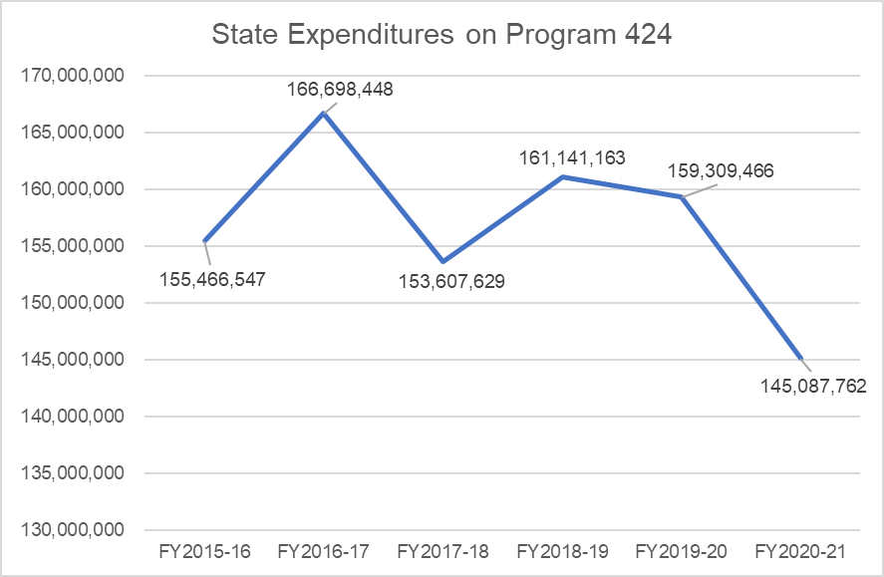
Nebraska Spending on DD Services
Program 424 – State Expenses
Since SFY 15-16, the amount spent on DD services has decreased.
SFY 2015-16 state expenses: $155,466,547
SFY 2020-21 state expenses: $145,087,762
Source: DAS Budget Portal

Slide 6
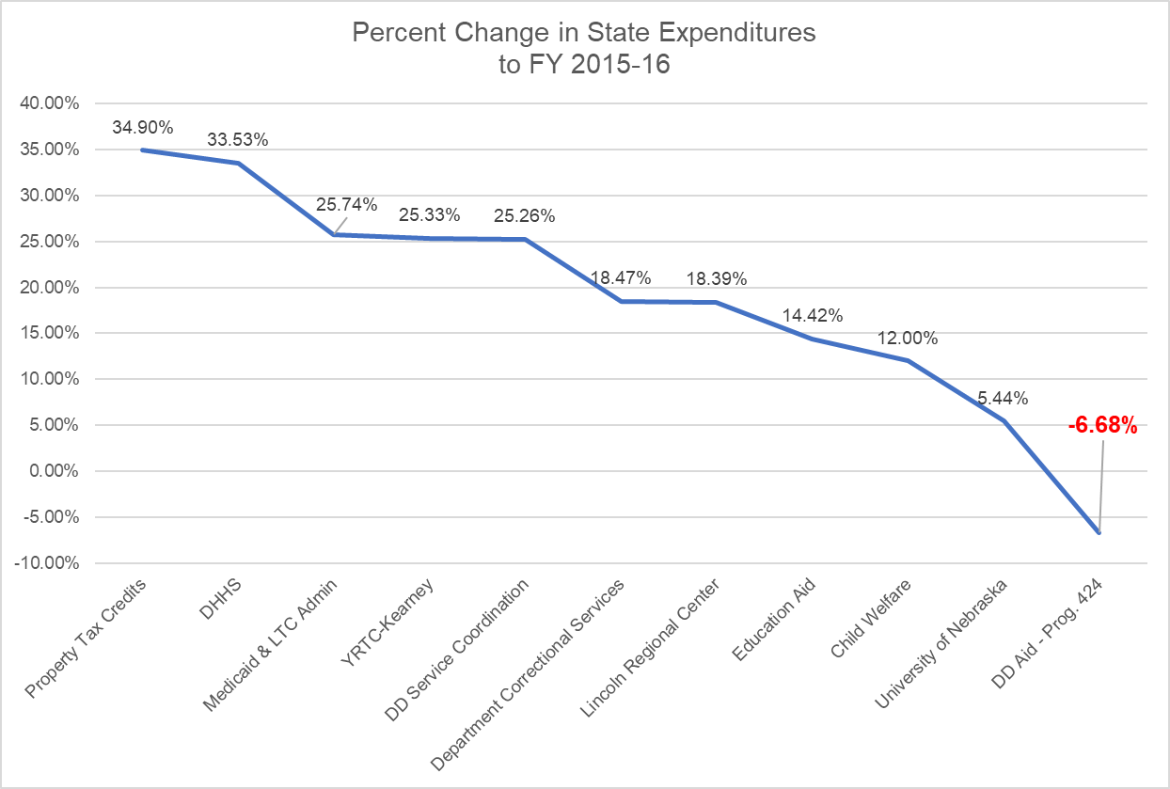
Nebraska Spending on DD Services
Program 424 – State Expenses
Over this six-year period, state spending on DD services has decreased 6.68%.
DD Service Coordination expenses has increased 25.26% over the same period.
Medicaid and Long-Term Care spending has increased 25.74% over the same period.
Source: DAS Budget Portal

Slide 7
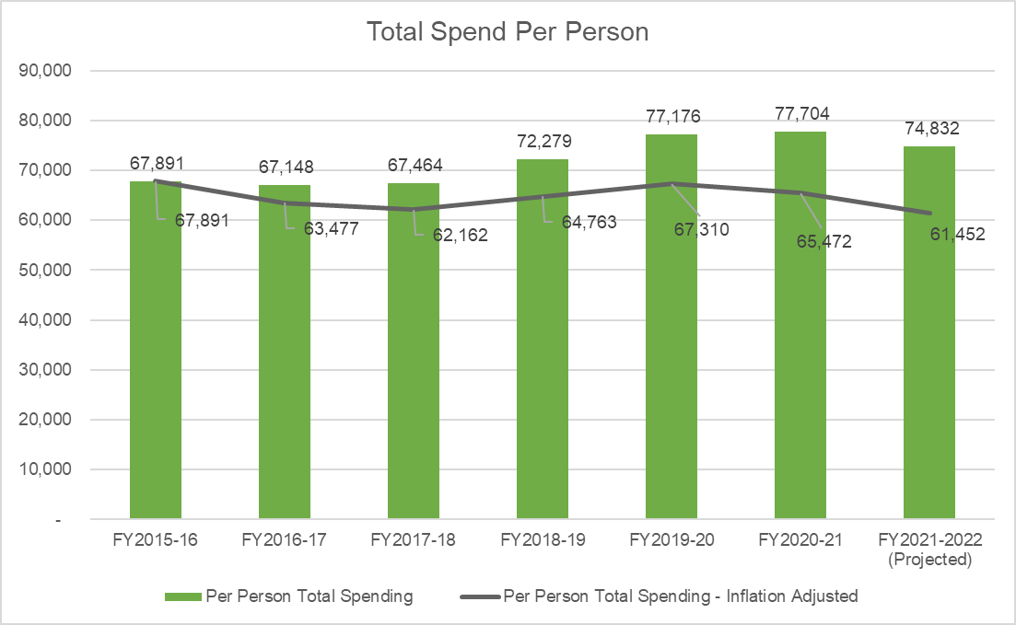
Nebraska Spending on DD Services
Program 424 – Total Expenses
The number of people being supported using Program 424 funds has increased over this six-year period, while state spending has decreased.
When accounting for inflation and increased census, the state of Nebraska’s total spend on DD services (with federal matching funds) has decreased by 9.48% per person supported.

Slide 8
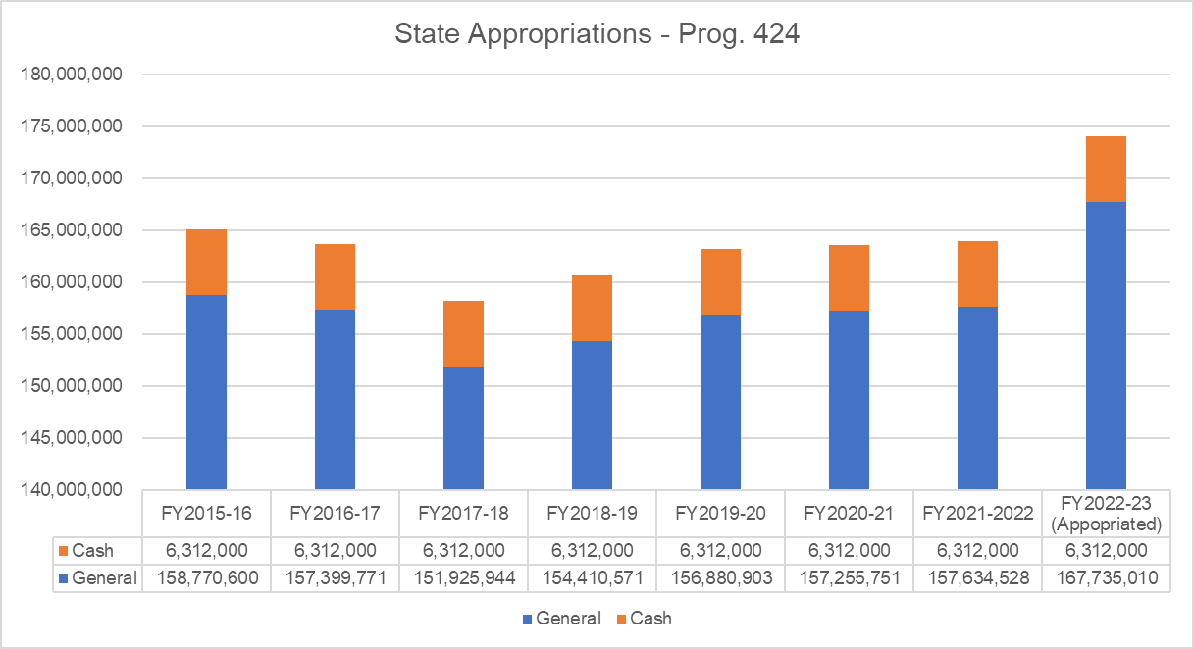
Nebraska Appropriations for DD Services
Program 424 – Appropriations
State appropriations have decreased slightly through SFY 20-21.
Appropriations were passed in 2021 to increase Program 424 for SFY 21-22 and 22-23.
Instead, Program 424 has remained flat, and the DD census has increased.
Source: DAS Budget Portal

Slide 9
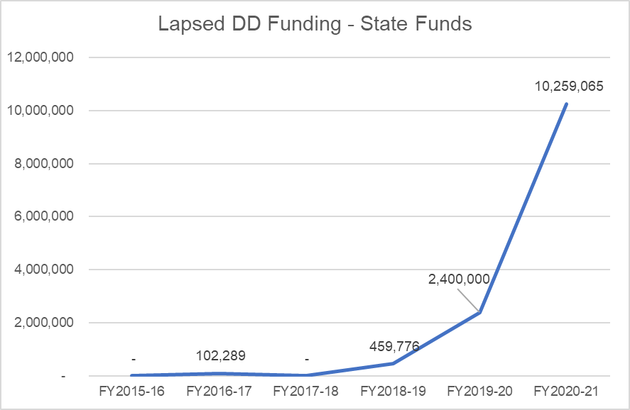
Nebraska Appropriations for DD Services
Program 424 – Appropriations
Money for DD services has been reappropriated for the past three state fiscal years.
The Division of Developmental Disabilities (DDD) returned 6.3% of their SFY 20-21 appropriation to the general fund.
If the 6.3% had been spent on DD services, it could have resulted in nearly $27 million for DD last year (after federal matching funds).
Source: DAS Budget Portal

Slide 10
Current SFY Spending by DDD
Program 424 – Current Year Spending
DDD is underspending their appropriation at a record rate. DDD will leave over $68 million on the table if their spending patterns do not change.
As of December, DDD has only spent 39.1% of available appropriations.
Money given for DD services by the Appropriations committee is not being spent.
Source: DAS Allotment Reports
Program 424 Expenditures (through December 2021):
Percent of Appropriation Expended:
Calendar Time Elapsed in SFY:
Total Underspend through Dec. 2021 –
(state funds only):
SFY 21-22 Appropriations:
Projected SFY 21-22 DD Underspend –
(state funds only):
Total Projected SFY 21-22 Projected Underspend –
(with federal match):
$69,240,092
42.23%
50.41%
$13,405,353
$163,946,528
$26,592,646
$68,621,548

Slide 11
DD providers in Nebraska need a 30% increase in rates to maintain adequate service levels.
DD Providers are suffering from unprecedented losses and a funding model that has not kept pace.
State appropriations for DD services are being returned to the general fund and are not maximizing federal resources.
DDD reappropriation/lapsed funds totaled over $10.2 million last year.
Adjusting for inflation, total DD cost per person receiving services is lagging by nearly 10%.

Slide 12
Supporting struggling DD providers meets the goals stipulated by SLFRF and ARPA.
DD Providers check 3 of the 4 boxes for ARPA use. Providers were broadly and severely negatively impacted by the COVID-19 pandemic through revenue loss, increased costs, and changes to the way services are delivered.
On average, DD providers across Nebraska’s starting pay for front-line, essential workers is $13.27 per hour, with providers reporting the need to hire 30% of their workforce. Premium pay for these jobs is critical.
The Coronavirus State and Local Fiscal Recovery Funds (SLFRF) guidance by the US Dept. of Treasury outlines four basic uses of funds: lost public sector revenue, response to far-reaching public health and negative economic impacts of the pandemic, provide premium pay for essential workers, and investment in particular infrastructure.
Supporting LB 1172 will ensure Nebraska is in alignment with guidance from the Department of Treasury and is making a significant investment in one of the industries most harshly impacted by the COVID-19 pandemic.

Slide 13
Supporting struggling DD providers meets the ARPA Eligibility Checklist
Providers are experiencing dramatic negative economic impact. Funding these requests will raise the incomes of people making low wages, will assist small businesses, non-profits, and impacted industries.
LB 1172 would help providers build public sector capacity in providing services to people with developmental disabilities. Currently there are funded waitlist offers not being met due to provider capacity limits.
DD services are medical services and behavioral health combined. Also, some of the most challenging people to support are often violent. With properly paid, experienced, appropriate staffing, we can help solve those issues.
Many providers were providing premium pay to front-line workers when the state was supporting DD provider rates. However, without knowing that LBs 1172 and 893 are passing, it is challenging to continue those premiums in the future.

Slide 14
DD providers in Nebraska need a 30% increase in rates to maintain adequate service levels.
What can you do to stabilize and bolster DD services in Nebraska?
Support LB 893, sponsored by Chairman Stinner, which increases the DD base appropriation by 15% for SFY 22-23.
Support LB 1172, sponsored by Senator Hilkemann, which uses ARPA funds to adds 15% to provider-based services conducted by front-line employees for SFY 22-23.

